Slide 1
Empowering Leaders of Tomorrow
Local Government Seminar January 31, 2019
Presented by:
Julie M. Robinson, City Administrator, City of Spring Valley Village
Wendy Ellis, City Administrator, City of Keemah

Slide 2
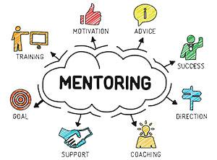
What is Mentoring?
Professional & Personal
Involves making yourself available to support and advise someone when they need it, delivering that support in a way that makes sense to them, and always keeping that person’s best interests in mind.

Slide 3
Types of Mentors
Peer
Focuses on helping specific skills and basic organization practices for how to get things done
Could be in same organization or in another organization
Career
What most people think of as mentorship
Serve as career advisor and advocate
Life
Can serve as objective sounding board when faced with a difficult issue (career or personal)

Slide 4
How Does It Happen?
Organically vs. Structured
What it looks like has changed over the years
Can last for years or for one coffee date/phone call/text

Slide 5
Tips for Being an Amazing Mentor
Approach each mentorship differently
Set expectations together in the very beginning
Take a genuine interest in your mentee as a person
Be present and open
Lead by example
Listen
Give honest feedback

Slide 6
Tips for Being an Amazing Mentor
Motivate and inspire
Celebrate their achievements
Give more than you ask for
Seek out classes or projects related to skills your mentee wants to develop

Slide 7
Tips for Being a Great Mentee
Make an intentional investment of your time and energy
Be clear on your needs
Respect your mentor – including their time
Be engaged and energizing – be an energy donor and not just an energy recipient
Take a genuine interest in your mentor

Slide 8
Tips for Being a Great Mentee
Take action
Ask questions
Be open to feedback
Be appreciative
Champion others

Slide 9
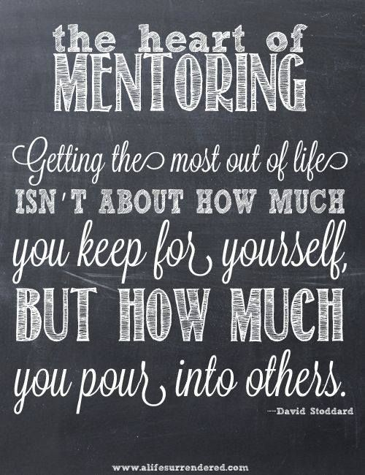
Final Thoughts

Slide 10
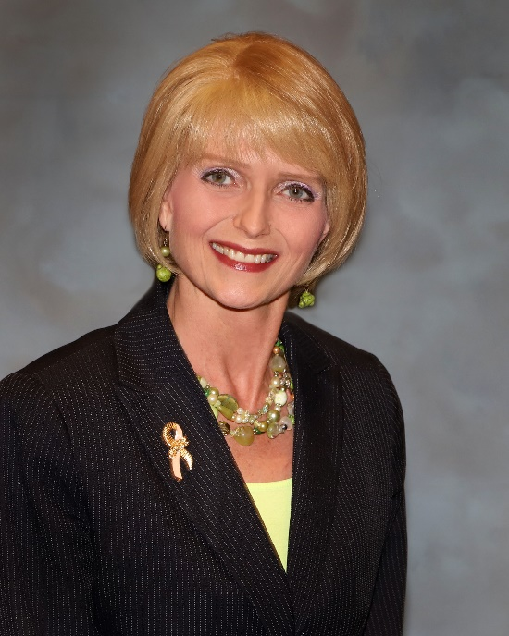
Questions?
Julie M. Robinson
Office: (713) 465-5306
Email: jrobinson@springvalleytx.com

